Slide 1
Index.
Overview … 2
Initial segmentation … 3
Structure proofreading … 4
Deep learning model fine-tunning … 8

Slide 2
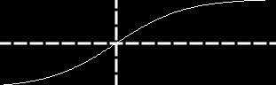
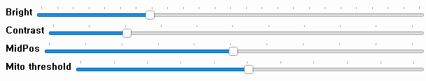
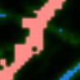
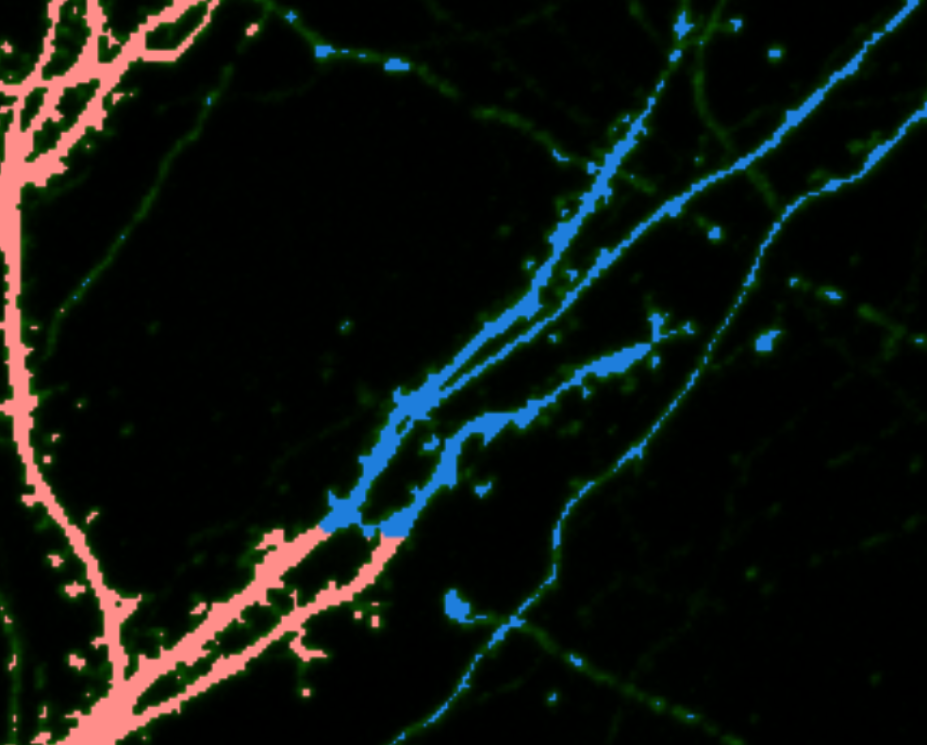
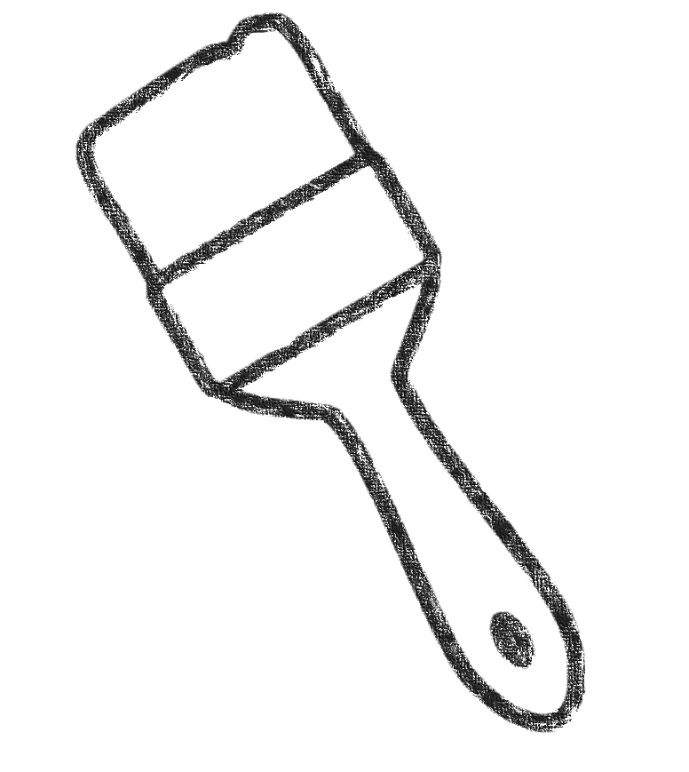
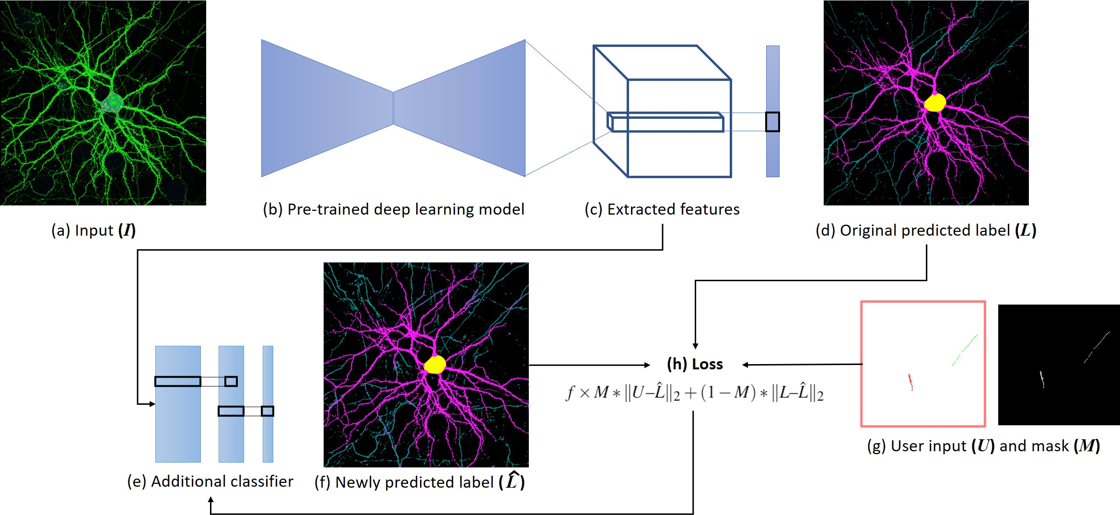
Background
Foreground
Overview
brush_size
p: user pressed pixel
User correction
Correct error part interactively
Initial segmentation
Refined segmentation
Fine-tunning & re-segmentation
Structure segmentation through pre-trained deep learning
If there are tool many error overall, fine-tunning the deep learning model through correction information

Slide 3
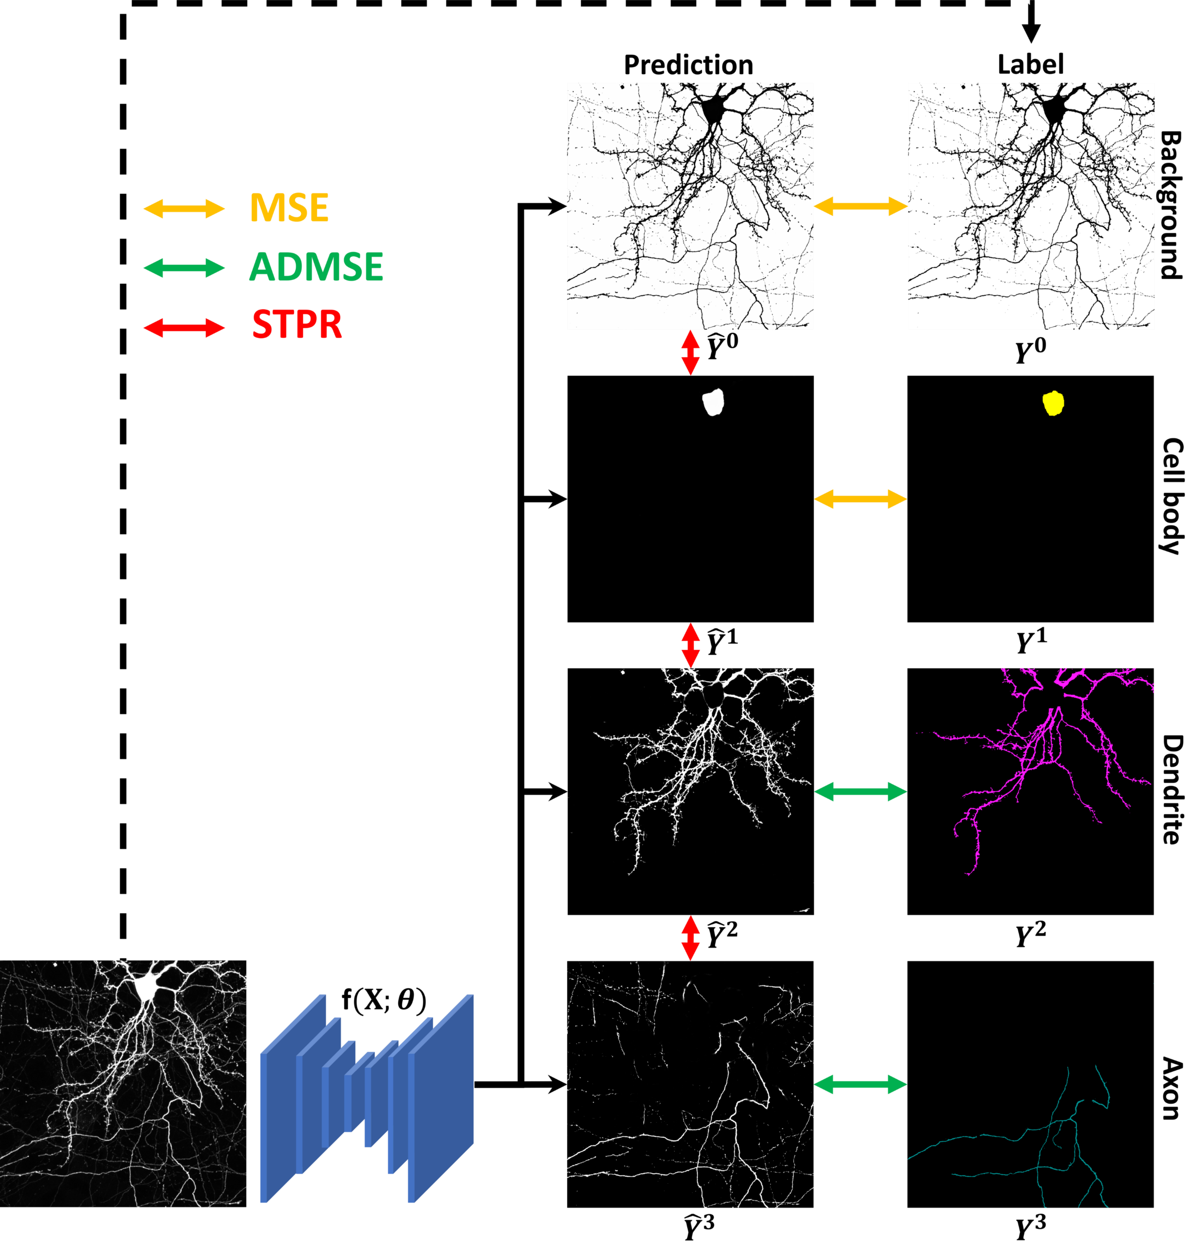
Initial segmentation
When the image is opened, the deep learning model is automatically loaded and segmentation is performed
“Neuron segmentation using incomplete and noisy labels via adaptive learning with structure priors”
Chanmin Park, et al. ISBI (2021)

Slide 4
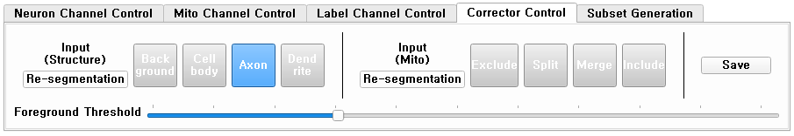
User correction
1. If it is judged that the image signal is too low or inappropriate, adjust the signal in Neuron Channel Control
Background
Foreground
3. Background brush is applied only to areas where the image signal is smaller than the foreground threshold.
Other brush is applied only to areas where the image signal is equal or greater than the foreground threshold.
brush_size
p: user pressed pixel
2. Select the structure input brush from the Corrector Control panel and drag the left mouse button on the error part.
* When you want to move the view of the image while the brush is selected, hold down the space key and drag the image.

Slide 5
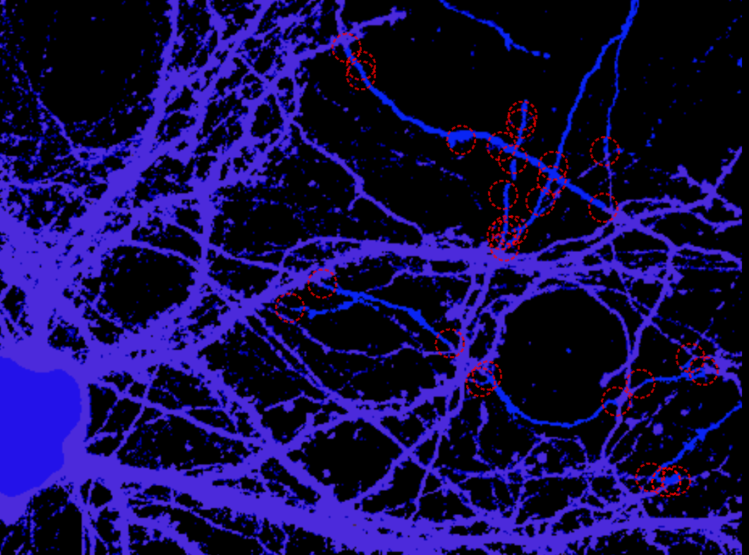
User correction
When the foreground threshold is adjusted with the structure brush selected, the foreground area preview (blue area) is visualized.

Slide 6
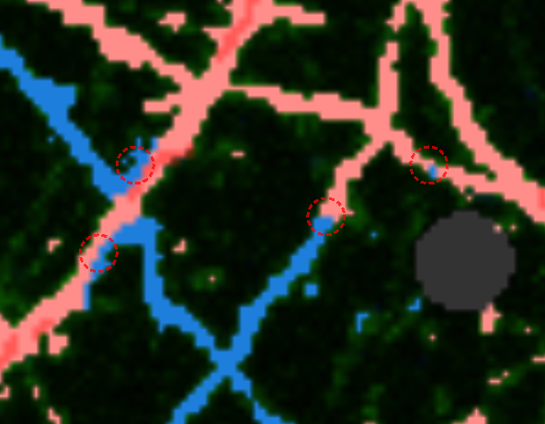
User correction
If the structure brush is selected, the area where the error is expected is recommended as a red circle (where multiple labels are mixed)

Slide 7
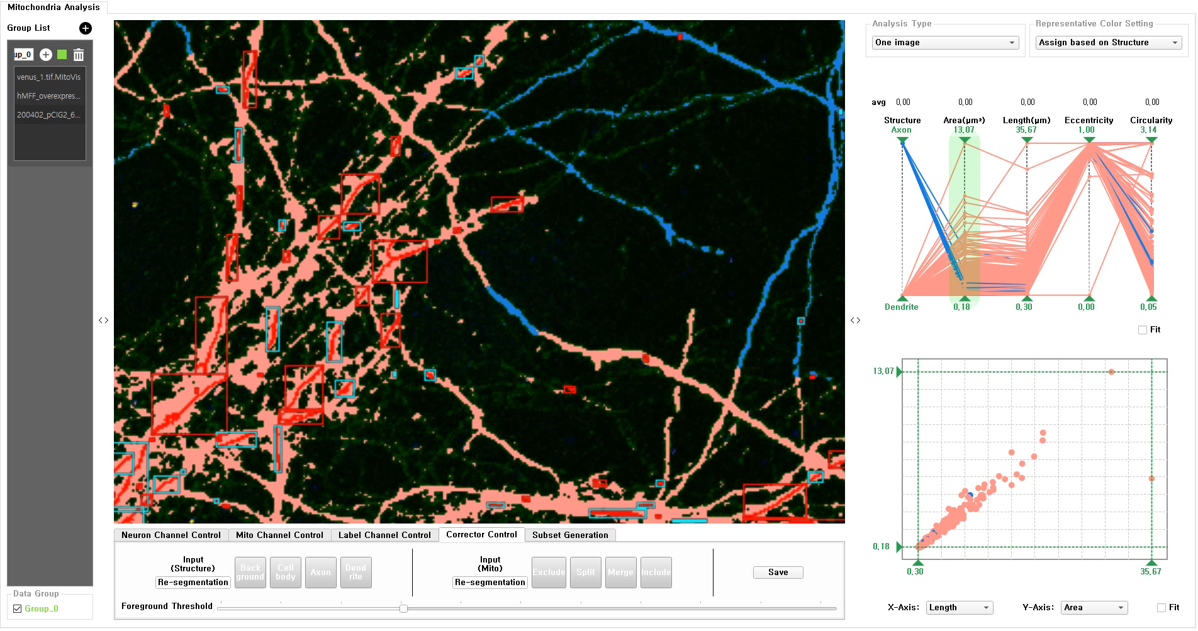
User correction (Demo)

Slide 8
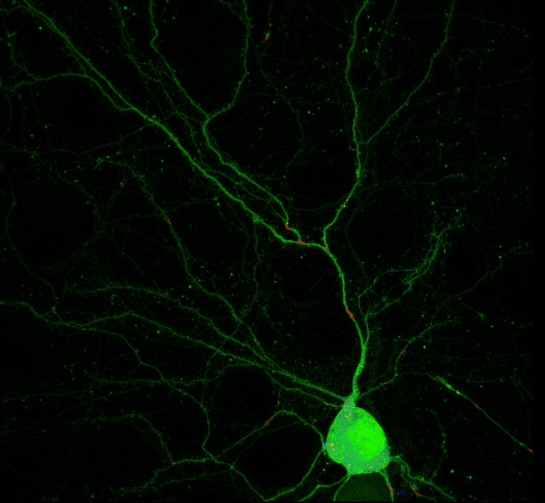
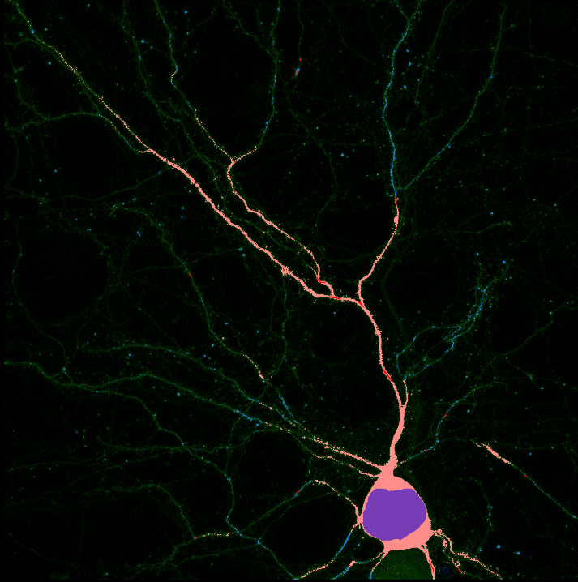
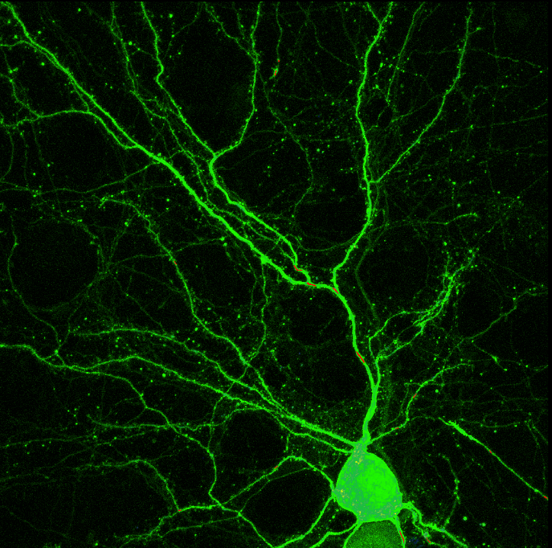
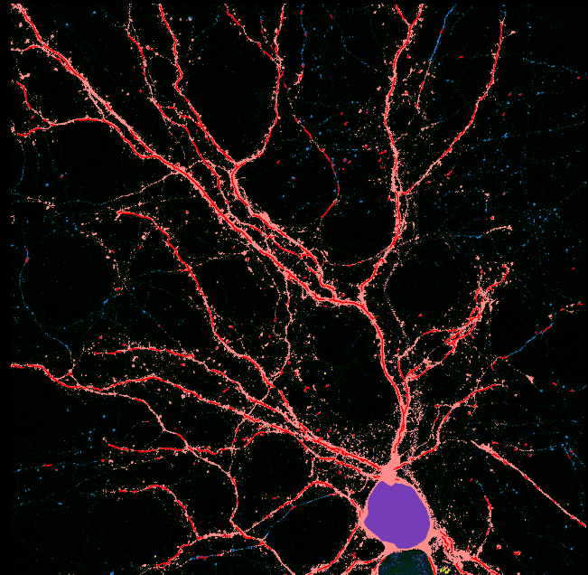


Fine-tunning &
re-segmentation
(Signal Improving)
When the signal of the image is too low to obtain a proper result, a new segmentation result can be obtained by clicking the Structure Re-segmentation button on the Corrector Control panel after adjusting the signal in Neuron Channel Control.

Slide 9
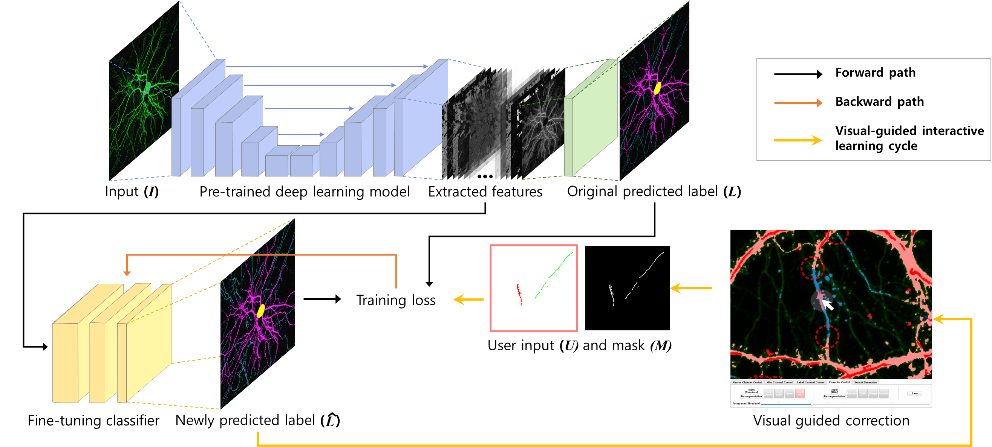
Fine-tunning &
re-segmentation
(Re-train with user correction)
After correction, if user click the Structure Re-segmentation button on the Corrector Control panel, the deep learning model is fine-tuned for 1 minute, and a new segmentation result can be obtained.
After checking the result and correcting the correction, fine-tuning can be performed again.

